Slide 1



Visualization of Data, Understanding and Interpretation
Unit 4 : AI-Assisted and Advanced Visualization
(UE24CS342AA9)
PPT 4: AI-Assisted Pattern and Anomaly Visualization
Dr.Prajwala TR (Course Instructor)
Dept. of CSE, PES University, Bangalore

Slide 2
Visualization of Data, Understanding and Interpretation
Acknowledgement
The slides are prepared from various resources from the Universities from abroad and India. Also, some material is taken from reliable resources from internet throughout this course.
TB1: C. O. Wilke, Fundamentals of Data Visualization (O’Reilly, 2019) — Ch. 7 distributions, Ch. 12 associations, Ch. 16 uncertainty (plus Ch. 9 boxplots and Ch. 22 captions where noted).
TB3: C. Ware, Information Visualization: Perception for Design, 4th ed. (Morgan Kaufmann, 2021) — Ch. 5 visual salience and Ch. 6 pattern perception.

Slide 3
Visualization of Data, Understanding and Interpretation
Acknowledgement (contd.)
T. Munzner, Visualization Analysis and Design (CRC Press, 2014) — Ch. 2 data abstraction, Ch. 3 tasks and derived data, Ch. 5 marks, channels and pop-out.
The syllabus row also lists anomaly-detection and visual-analytics literature. Slides that rely on it (anomaly taxonomy, detector evaluation, automation bias) are labelled ‘Additional literature’ and are not attributed to the textbooks.

Slide 4
Visualization of Data, Understanding and Interpretation
Lecture Overview
AI-assisted pattern recognition: how algorithmic output becomes something we can see
Distributions and associations as the basic pattern views (histograms, density plots, scatterplots, PCA)
Automated trend and cluster detection
Outlier identification and anomaly detection: point, contextual and collective anomalies
Visual highlighting and automated annotation of AI-detected anomalies

Slide 5
Visualization of Data, Understanding and Interpretation
Lecture Overview (contd.)
Human verification, false positives and false negatives, detector evaluation
Uncertainty in algorithmic findings
Saliency and attention in AI-generated highlights; avoiding visual overemphasis
4 worked numericals and 8 MCQs

Slide 6
Visualization of Data, Understanding and Interpretation
Why AI-Assisted Pattern And Anomaly Visualization?
Textbook reference: Ware (TB3), Ch. 1 (G1.1, G1.2); Munzner, §3.5; Additional literature (syllabus row), not a section of the three textbooks — Keim et al. (2008) on visual analytics
Datasets are often too large to inspect item by item; an algorithm can scan every item and rank them.
Human vision is excellent at seeing structure, provided the design lets important patterns be perceived quickly (Ware, G1.1).
The combination: the machine proposes candidates, the visualization presents them, the human judges them.
The risk: algorithmic output can mislead — false alarms, missed cases, over-trust. This lecture is about designing for both the benefit and the risk.

Slide 7
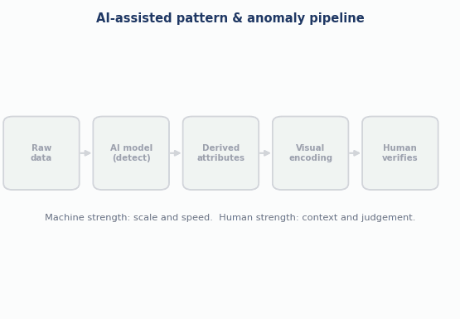
Visualization of Data, Understanding and Interpretation
AI-Assisted Pattern Recognition
An algorithm scans all items and outputs scores, cluster IDs or labels.
Visualization encodes that output so people can see it in context.
The human verifies; feedback tunes the model and thresholds.
Animation: the pipeline, stage by stage.
Source: Munzner §3.4.2 (derive); Additional literature (syllabus row), not a section of the three textbooks (Keim et al. 2008) — original animation generated for this lecture

Slide 8
Visualization of Data, Understanding and Interpretation
Data Abstraction For Pattern Analysis
Textbook reference: Munzner, Ch. 2 ‘Data Abstraction’, pp. 21–40
Before choosing a view, abstract the data: what are the items, and what are their attributes?
Munzner (Ch. 2) distinguishes dataset types (tables, networks, fields, geometry) and attribute types: categorical, ordered (ordinal or quantitative).
Attribute semantics matter too: keys versus values, and temporal attributes.
For AI-assisted analysis, the items stay the same; the algorithm adds new attributes to each item (score, cluster ID, flag).

Slide 9
Visualization of Data, Understanding and Interpretation
Derived Attributes: The Bridge From AI Output To Visual Encoding
Textbook reference: Munzner, §3.4.2.3 ‘Derive’, pp. 50–53; Ch. 5 magnitude vs. identity channels
Munzner’s derive action creates new data from existing data; the new attribute can then be encoded like any other.
Anomaly score → a derived quantitative attribute (ordered): use a magnitude channel such as position, length or saturation.
Cluster ID → a derived categorical attribute: use an identity channel such as hue or shape.
Anomaly flag → a binary categorical attribute: simple to see, but it hides how close an item was to the threshold.

Slide 10
Visualization of Data, Understanding and Interpretation
What Is A Pattern? Trends, Outliers And Features
Textbook reference: Munzner, §3.5 ‘Targets’, pp. 55–57 (Figure 3.6)
A trend is a high-level characterization of a pattern in the data; the simplest example is an increase or decrease over time.
Outliers (also called anomalies, novelties, deviants or surprises) are items that do not fit the pattern.
Features are task-dependent structures of interest; what counts as one depends on what the analyst is looking for.
For attributes, the related targets are distribution, extremes, dependency, correlation and similarity.

Slide 11
Visualization of Data, Understanding and Interpretation
Seeing Patterns: What Human Perception Contributes
Textbook reference: Ware (TB3), Ch. 6 ‘Static and Moving Patterns’, G6.1; Munzner, §5.5.5 ‘Grouping’, p. 111
Ware (Ch. 6): pattern perception sits between low-level feature detection and object recognition; only a few objects can be held in visual working memory at once.
Gestalt principles of proximity and similarity make nearby or alike marks group perceptually — which is how we see clusters.
Design rule (G6.1): place symbols that represent related information close together.
Munzner (§5.5.5): grouping can also be shown by containment or connection; containment is the strongest cue.

Slide 12
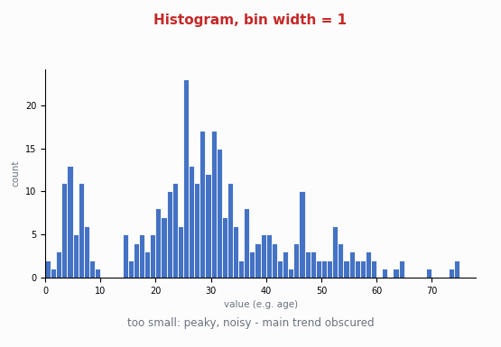
Visualization of Data, Understanding and Interpretation
Histograms: The First View Of A Distribution
A histogram counts items in bins; the shape depends on the bin width.
Too narrow: noisy and peaky. Too wide: real features (a dip, a small tail) vanish.
So explore several bin widths before trusting a shape.
Animation: one dataset, four bin widths.
Source: Wilke (TB1) Ch. 7 ‘Visualizing distributions: histograms and density plots’ — original animation generated for this lecture (synthetic data)

Slide 13
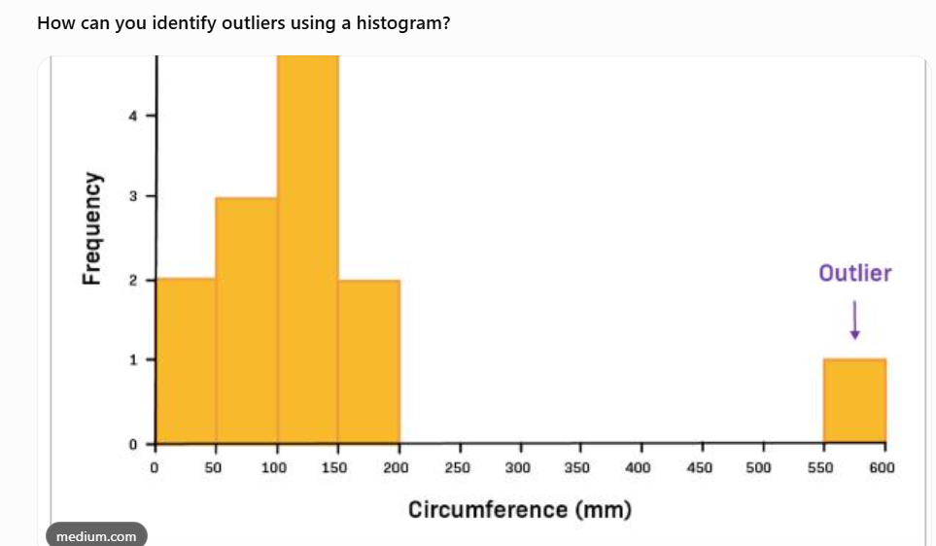
Visualization of Data, Understanding and Interpretation
Histograms And Outliers
Textbook reference: Wilke (TB1), Ch. 7 (bin-width discussion); application to outliers is this lecture’s interpretation
Isolated, sparsely filled bins far from the main mass are the visual signature of outliers.
A bin width that is too wide merges a small far tail into a neighbouring bar and hides it.
A bin width that is too narrow makes every random gap look suspicious.
Take-away: a histogram is itself a parameterised algorithm; its parameter changes what we think is anomalous.

Slide 14
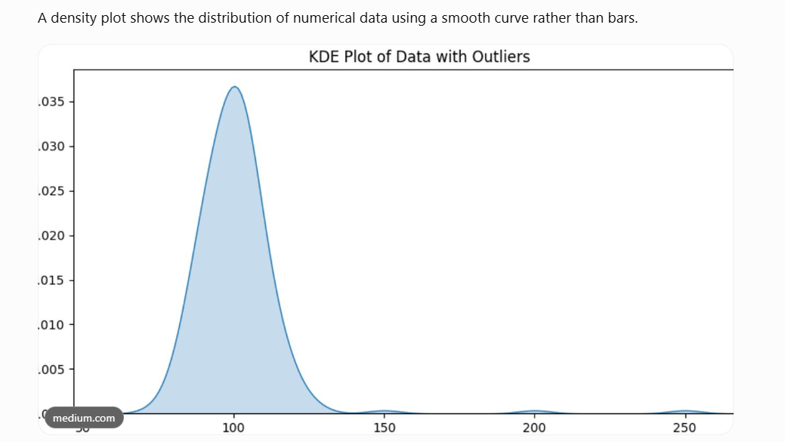
Visualization of Data, Understanding and Interpretation
Density Plots
Textbook reference: Wilke (TB1), Ch. 7 ‘Density plots’ (kernel density estimation, bandwidth, caveats)
A kernel density estimate places a small smooth bump at each data point and adds the bumps up.
The bandwidth plays the role of bin width: too small gives wiggles, too large smooths away structure.
The kernel and bandwidth change the picture, so a density curve is an estimate, not the data.
Density curves can extend into regions where no data exist or could exist, so read the tails with care.

Slide 15
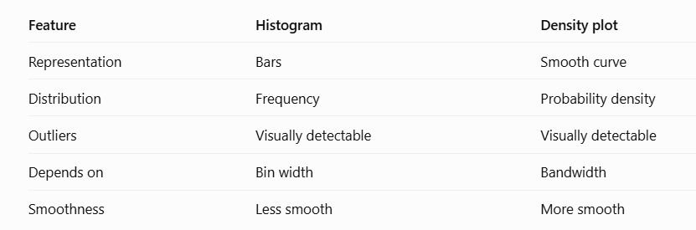
Visualization of Data, Understanding and Interpretation
Looking At The Distribution Of AI Scores
Textbook reference: Wilke (TB1), Ch. 7 (multiple distributions); Additional literature (syllabus row), not a section of the three textbooks for the detector-score application
Plot the distribution of anomaly scores before choosing a cut-off.
A clearly separated tail suggests a natural threshold; a smooth continuum means any cut-off is a judgement call.
Compare score distributions of flagged and unflagged groups with density plots rather than stacked histograms, which are hard to compare.
Application of Wilke Ch. 7 to detector outputs; the lecture’s own design advice.

Slide 16
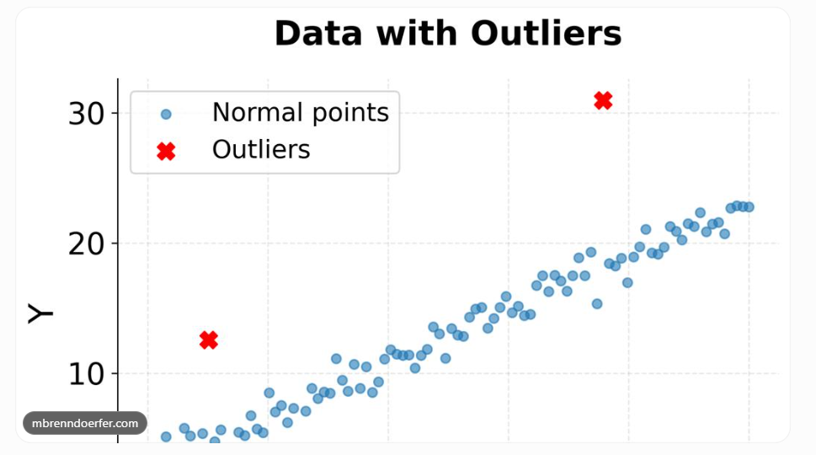
Visualization of Data, Understanding and Interpretation
Visualizing Associations: Scatterplots
Textbook reference: Wilke (TB1), Ch. 12 ‘Visualizing associations among two or more quantitative variables’, scatterplots
A scatterplot shows the relationship between two quantitative variables, one dot per item.
A third variable can be added by colour or shape (to separate subgroups) or by size (a bubble chart, harder to judge).
Trends, clusters and isolated points are all visible in one view — before any algorithm runs.
Heavy overplotting hides structure; use transparency or smaller marks.

Slide 17
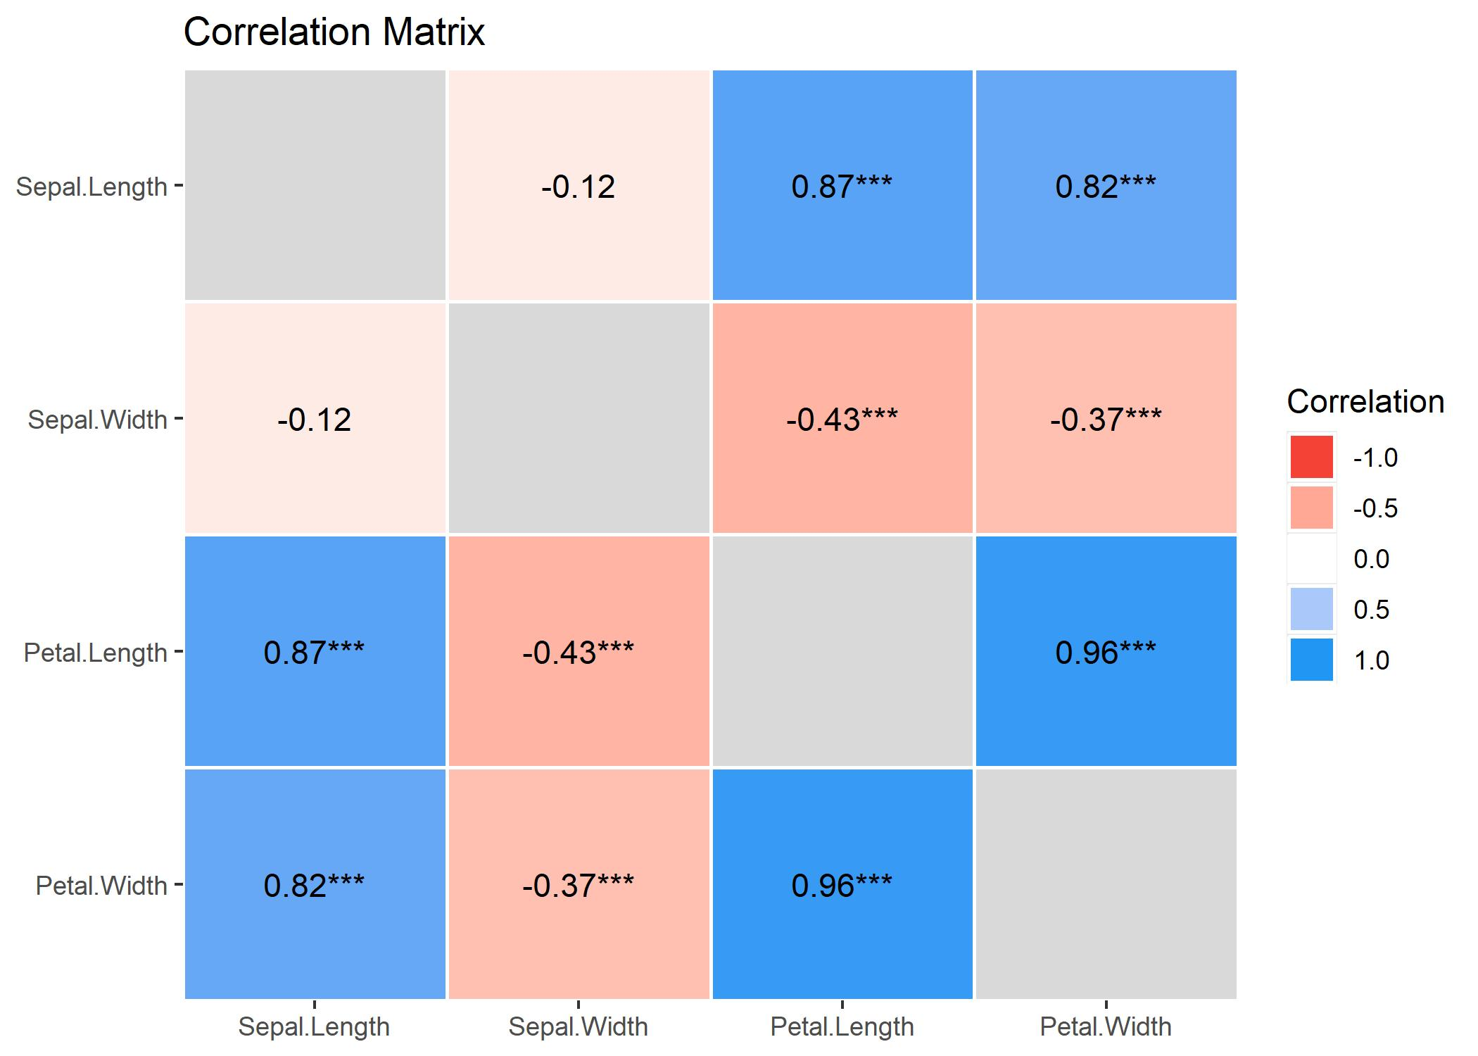
Visualization of Data, Understanding and Interpretation
Correlation And Correlograms
Textbook reference: Wilke (TB1), Ch. 12 ‘Correlograms’ (visualize raw data when possible)
The correlation coefficient summarizes the strength of a linear association between two variables in one number.
For many variables, a correlogram shows all pairwise correlations as a matrix of colours.
Wilke’s caution: a correlogram shows derived quantities, not the data; where possible look at the raw data too.
A single r cannot reveal curved relationships, clusters or outliers — the same lesson applies to anomaly scores.

Slide 18
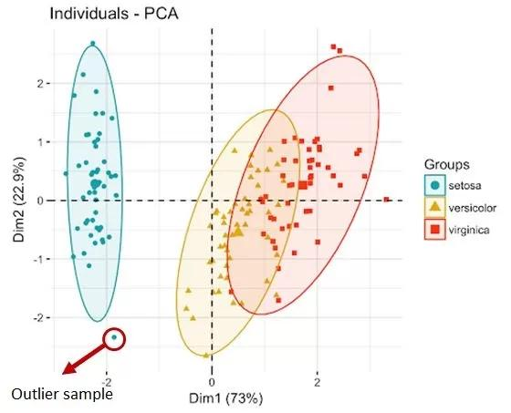
Visualization of Data, Understanding and Interpretation
Dimension Reduction And Clusters (PCA)
Textbook reference: Wilke (TB1), Ch. 12 ‘Dimension reduction’
Principal component analysis rotates the data to new axes (components) ordered by how much variation they capture.
Plotting the first two components often shows groups of similar items as visible clusters.
Items that fall far from every group are candidate outliers; Wilke’s example notes a few such cases in a component plot.
Caveat: components are combinations of the original variables and are harder to interpret than the variables themselves.

Slide 19
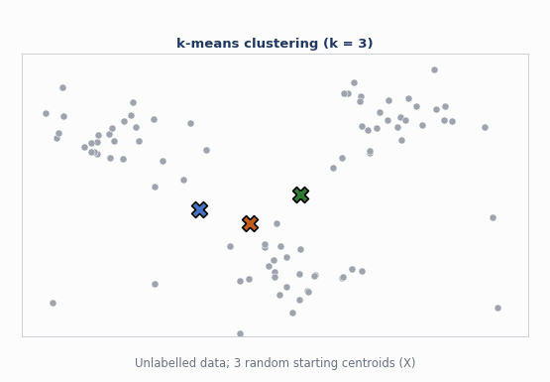
Visualization of Data, Understanding and Interpretation
Automated Trend And Cluster Detection
Trend detection: fit a model (line or smoother); the residuals show what it does not explain.
Clustering groups similar items; k-means alternates ‘assign’ and ‘update’.
k is chosen by the user, and every point still gets a label.
Animation: k-means with k = 3.
Source: Additional literature (syllabus row), not a section of the three textbooks (general ML practice); display choices follow Wilke (TB1) Ch. 12 — original animation generated for this lecture

Slide 20
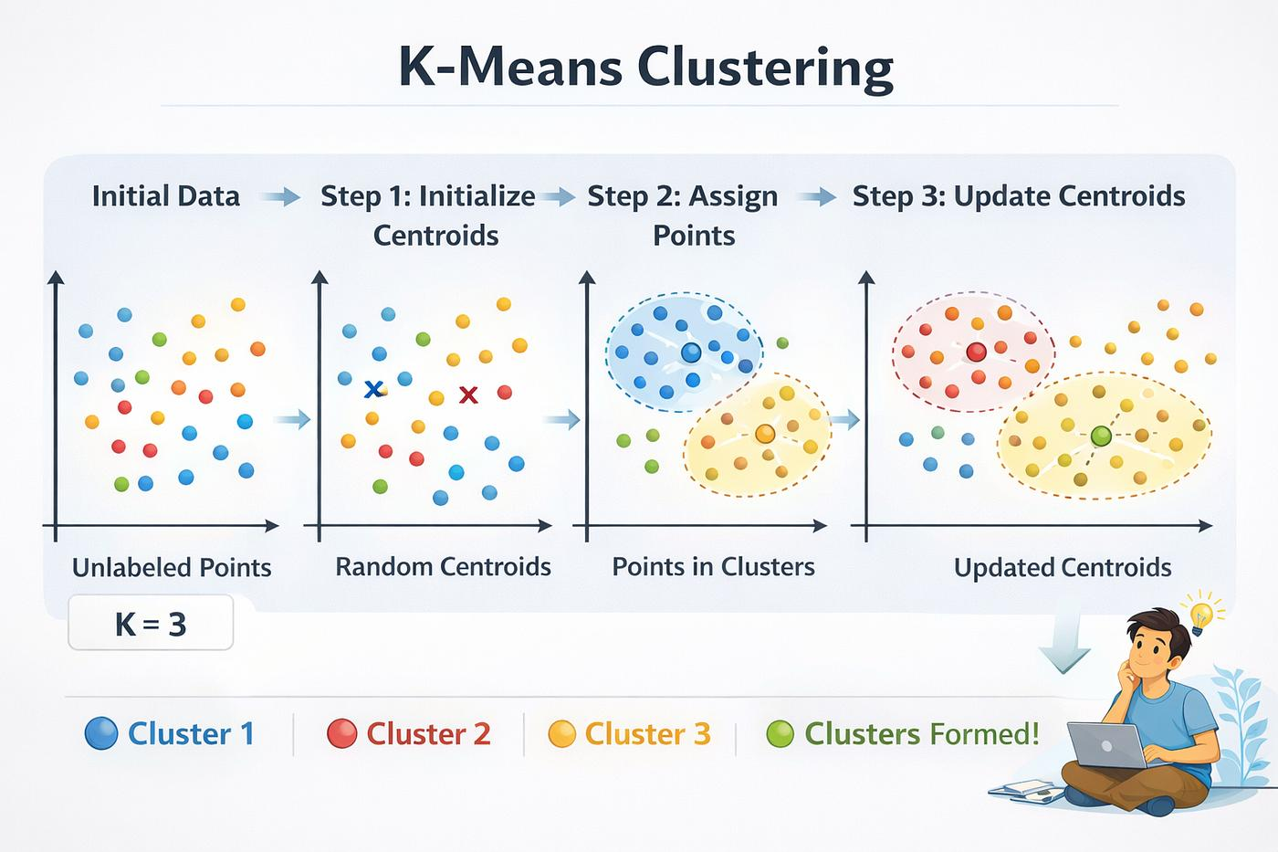
Visualization of Data, Understanding and Interpretation
Common Clustering Approaches
Textbook reference: Additional literature (syllabus row), not a section of the three textbooks — general ML practice (k-means; Ester et al. 1996; hierarchical clustering)
k-means: needs k in advance, assumes compact round groups, and forces every point (including outliers) into a cluster.
Density-based clustering (e.g., DBSCAN, Ester et al. 1996): finds groups of any shape and labels sparse points as noise — a built-in outlier signal.
Hierarchical clustering: builds a tree of merges so the analyst can choose the level of grouping.
Different algorithms and parameters give different groups; none is ‘the’ answer.

Slide 21
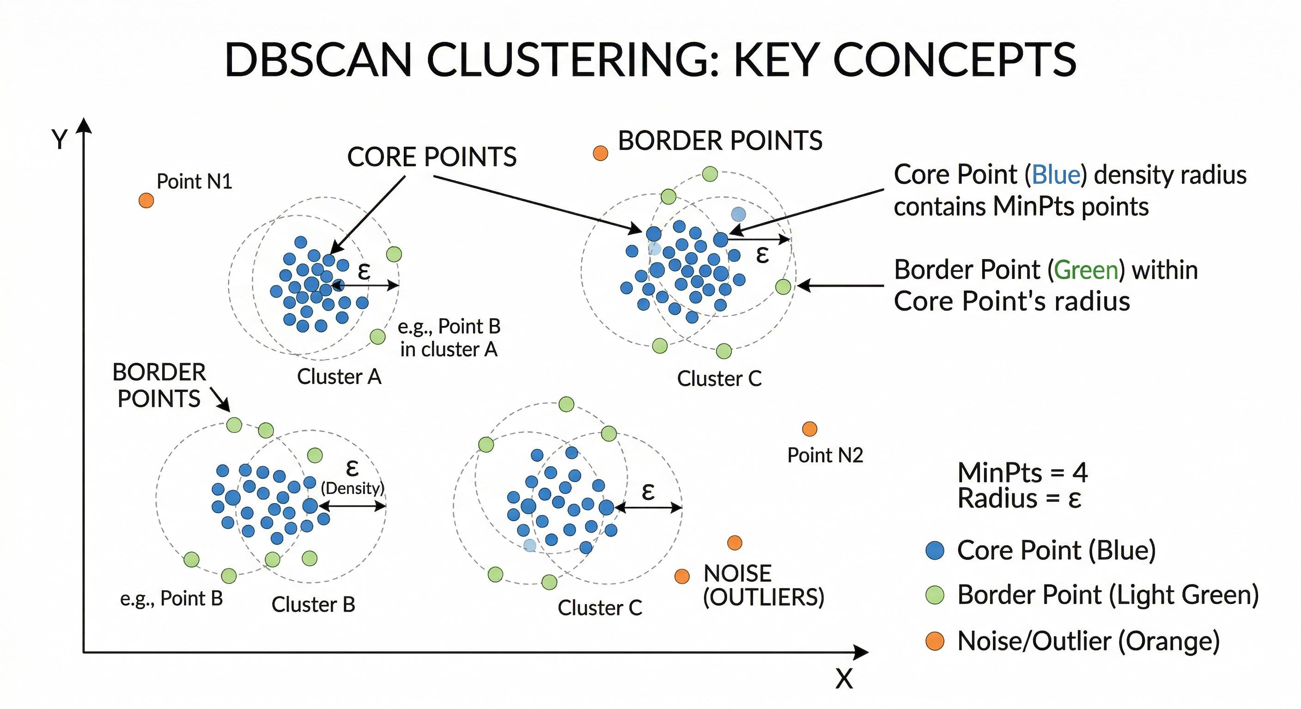
K-means clustering – Steps
Choose the number of clusters (K).
Initialize K centroids randomly.
Assign each data point to its nearest centroid.
Recalculate centroids using the mean of assigned points.
Repeat assignment and centroid update.
Stop when centroids no longer change significantly.
Hierarchical clustering – Steps
Start by treating every data point as a separate cluster.
Calculate distances between clusters.
Merge the two closest clusters.
Recalculate distances between the newly formed cluster and other clusters.
Repeat merging until all points form one cluster.
Draw a dendrogram (tree diagram).
Choose the desired number of clusters by cutting the dendrogram at a selected level.
DBSCAN clustering – Steps
Choose two parameters: Epsilon (ε) and MinPts.
Select an unvisited data point.
Find all neighbouring points within ε distance.
If neighbours ≥ MinPts, identify it as a core point.
Expand the cluster by connecting density-reachable points.
Mark points that do not belong to any cluster as noise (potential outliers).
Repeat until all points are visited

Slide 22
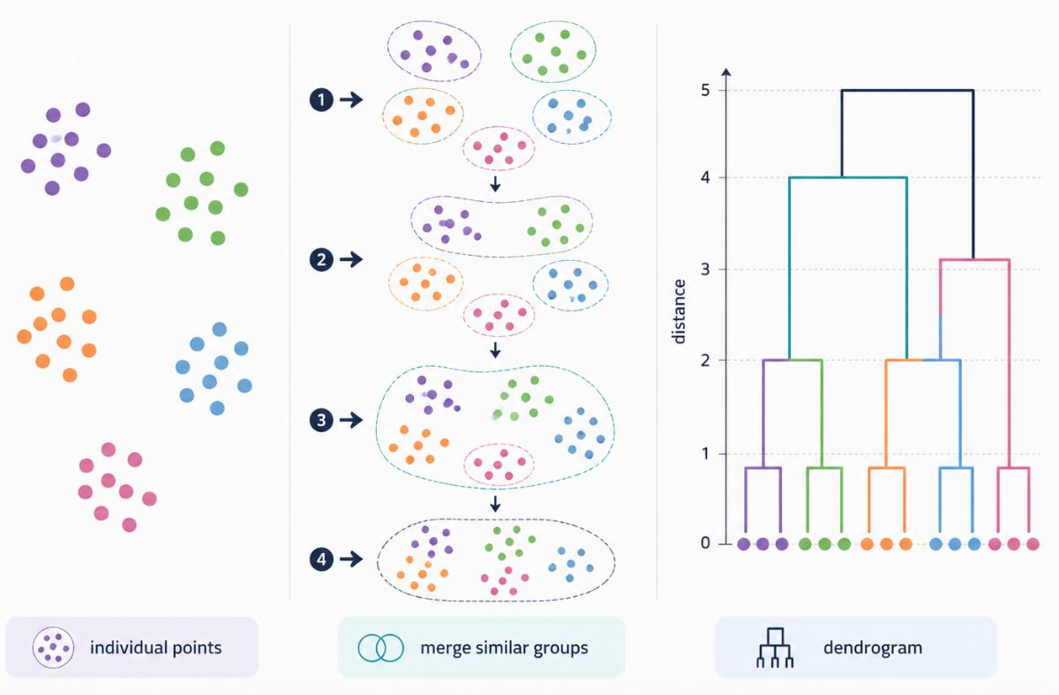

Slide 23
Visualization of Data, Understanding and Interpretation
Showing Detected Clusters Honestly
Textbook reference: Munzner, §5.5.5 ‘Grouping’; Wilke (TB1), Ch. 12; stability advice: lecture design guidance
Encode cluster ID with an identity channel (hue or shape), keeping position for the data’s own coordinates.
Draw group outlines (containment) sparingly: Munzner notes containment is a strong grouping cue, so a hard outline implies a crisp boundary the data may not have.
Always let the viewer see the raw points beneath the labels (Wilke: raw data over derived summaries).
State the algorithm and parameters, and show how stable the clusters are under other settings.

Slide 24
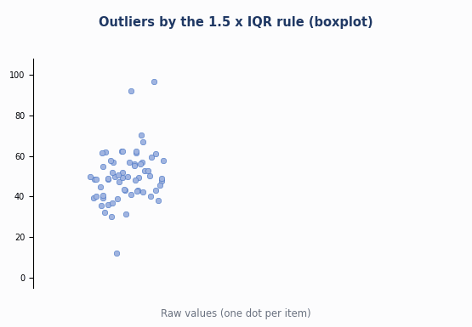
Visualization of Data, Understanding and Interpretation
Outlier Identification
Visually: far tails in a histogram, isolated points in a scatterplot.
Boxplot rule: points beyond 1.5 × IQR from the box are drawn individually as outliers.
z-score rule: flag |z| above a cut-off such as 3.
Animation: building the boxplot fences.
Source: Wilke (TB1) Ch. 9 (boxplots); Munzner §3.5 (outliers) — original animation generated for this lecture (synthetic data)

Slide 25
Visualization of Data, Understanding and Interpretation
Outlier And Anomaly Detection Method Families
Textbook reference: Wilke (TB1) Ch. 9 (IQR rule); Additional literature (syllabus row), not a section of the three textbooks: Breunig et al. 2000 (LOF), Liu et al. 2008 (Isolation Forest)
Family | Idea | Strength | Weakness
z-score | Distance from mean in standard deviations | Simple, fast | Mean and SD are distorted by the outliers themselves
IQR fences | Beyond Q1 − 1.5 IQR or Q3 + 1.5 IQR | Robust, no normality assumption | One variable at a time
Distance / density | Far from neighbours, or sparser than neighbours (e.g., LOF) | Handles several variables | Needs a distance measure; scales poorly
Isolation | Anomalies are separated by few random splits (Isolation Forest) | Fast on large data | Scores need careful thresholding
Reconstruction | A model that learns normal data reconstructs anomalies poorly | Captures complex normal behaviour | Hard to explain why an item was flagged

Slide 26
Visualization of Data, Understanding and Interpretation
Anomaly Detection
Textbook reference: Additional literature (syllabus row), not a section of the three textbooks — Chandola, Banerjee & Kumar (2009), ACM Computing Surveys 41(3); Munzner §3.4.2.3
Anomaly detection finds items or patterns that deviate from expected behaviour; ‘anomaly’ and ‘outlier’ are often used interchangeably.
Supervised methods learn from labelled anomalies; semi-supervised methods learn only normal behaviour; unsupervised methods need no labels.
Most detectors output a score per item; a threshold turns the score into an alert.
The score is a derived attribute (Munzner) — it should be visualized and examined, not only thresholded.

Slide 27
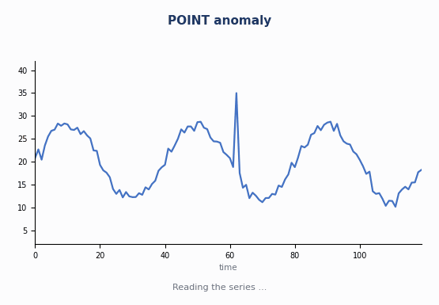
Visualization of Data, Understanding and Interpretation
Types Of Anomalies
Point: one value stands apart from all the others.
Contextual: normal in general, abnormal in its context (time, season, place).
Collective: individually normal values that are abnormal together.
Animation: the three types on a time series.
Source: Chandola, Banerjee & Kumar (2009), ACM Computing Surveys 41(3) — original animation generated for this lecture

Slide 28
Visualization of Data, Understanding and Interpretation
Point Anomalies
Textbook reference: Additional literature (syllabus row), not a section of the three textbooks — Chandola et al. (2009); highlighting rule from Ware (TB3) G5.6
A single data instance that is anomalous with respect to the rest of the data — the simplest and most studied case.
Example: one transaction amount far larger than every other transaction.
Detection: thresholds on a score, distance from neighbours, or isolation.
Visual design: a strip plot, scatterplot or histogram tail makes it visible; highlight the single mark (Ware G5.6).

Slide 29
Visualization of Data, Understanding and Interpretation
Contextual Anomalies
Textbook reference: Additional literature (syllabus row), not a section of the three textbooks — Chandola et al. (2009)
A value that is anomalous only in a specific context; the same value elsewhere would be normal.
Context attributes (time, location, season) define the context; behavioural attributes (the value) are judged within it.
Example: a temperature of 35°F can be normal in winter yet anomalous in summer.
Visual design: show the context — a seasonal band, small multiples by period — or the viewer cannot judge the flag.

Slide 30
Visualization of Data, Understanding and Interpretation
Collective Anomalies
Textbook reference: Additional literature (syllabus row), not a section of the three textbooks — Chandola et al. (2009)
A group of related instances that is anomalous together, even though each instance may look normal.
Example: a sensor that flat-lines for half an hour, or an unusual sequence of events.
Detection needs a model of sequences or relationships, not just single values.
Visual design: highlight the whole extent (a band or span), not one mark; the interval is the finding.

Slide 31
Visualization of Data, Understanding and Interpretation
Anomaly Types Compared
Textbook reference: Additional literature (syllabus row), not a section of the three textbooks — Chandola et al. (2009); design column is this lecture’s guidance
Type | What is abnormal | Needs to know | How to show it
Point | A single instance | The overall distribution | Highlight one mark
Contextual | An instance in its context | Context attributes (time, place) | Show context beside the mark
Collective | A group of instances together | Relationships or sequence | Highlight the whole span

Slide 32
Visualization of Data, Understanding and Interpretation
Visual Highlighting Of AI-Detected Anomalies
Textbook reference: Ware (TB3), Ch. 5 (G5.4–G5.8); Munzner, §5.5.4 ‘Popout’, p. 109
Highlighting must make flagged items easy to find without destroying the rest of the picture.
Ware G5.6: for maximum pop-out a symbol should be the only object distinctive on a feature channel.
G5.7 and G5.8: use a positively asymmetric cue, on the feature dimension used least elsewhere in the design.
Munzner (§5.5.4): pop-out time does not depend on the number of distractors for a single distinct target.

Slide 33
Visualization of Data, Understanding and Interpretation
Choosing A Channel For Highlighting
Textbook reference: Ware (TB3) Ch. 5 (G5.7–G5.9); Munzner Ch. 5 (channels); channel summary is this lecture’s synthesis
Channel | Pop-out | Cautions
Hue (colour) | Strong when only the flagged items differ | May already encode a category; colour-deficient viewers
Size | Strong | Changes the apparent magnitude of the data
Shape / marker | Good for a few items | Many shapes are hard to tell apart
Outline / halo | Moderate; keeps the base colour | Less visible on dense plots
Motion / blink | Very strong (Ware G5.9) | Keep it subtle; distracting and hard to ignore
Position / rank list | Strong (a magnitude channel) | Needs space; separates items from context

Slide 34
Visualization of Data, Understanding and Interpretation
Automated Pattern Annotation
Textbook reference: Munzner, §3.4.2.1 ‘Annotate’, p. 49; Wilke (TB1), Ch. 22 ‘Titles, captions, and tables’
Munzner’s annotate action adds graphical or textual notes tied to existing elements; an annotation can be seen as a new attribute of those items.
Algorithms can generate annotations: cluster labels, trend arrows, and reason codes such as ‘+3.4 SD above seasonal norm’.
Wilke (Ch. 22): a good title or caption states the point of the figure — generated text should do the same, briefly.
Mark machine-generated notes as such, and keep them few: every label competes for attention and legibility.

Slide 35
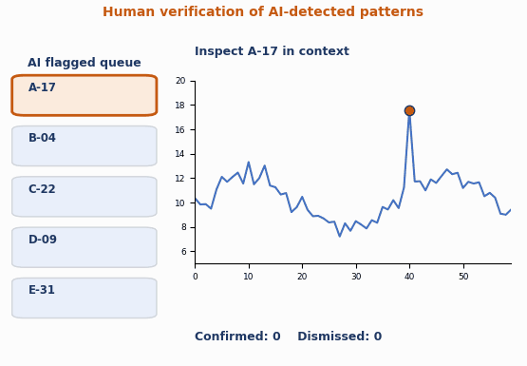
Visualization of Data, Understanding and Interpretation
Human Verification Of Detected Patterns
Flagged cases are candidates, not conclusions.
The analyst inspects each in context, then confirms or dismisses it.
Decisions flow back to tune the thresholds and labels.
Animation: reviewing a queue of AI flags.
Source: Munzner §3.4.1 (discover, verify); Additional literature (syllabus row), not a section of the three textbooks (Keim et al. 2008) — original animation generated for this lecture

Slide 36
Visualization of Data, Understanding and Interpretation
What The Reviewer Needs
Textbook reference: Munzner, §6.5 ‘Eyes beat memory’; Ch. 11–12 (interaction, linked views)
Context: the surrounding data, not the flagged point alone — comparing visible views is easier than comparing against memory (Munzner, ‘eyes beat memory’).
Details on demand: the raw record, the score and the main reason for the flag.
Linked views and selection (previous lecture) so a flagged item can be traced across views.
A way to act: confirm, dismiss, add a label — and to see which flags were already reviewed.

Slide 37
Visualization of Data, Understanding and Interpretation
False Positives And False Negatives
Textbook reference: Additional literature (syllabus row), not a section of the three textbooks — standard detector-evaluation terminology
False positive (FP): the detector flags a normal item — a false alarm that wastes review effort.
False negative (FN): the detector misses a real anomaly — often the more costly error.
True positive (TP) and true negative (TN) are the correct decisions; the four counts form the confusion matrix.
The two errors trade off against each other through the threshold, and their costs are rarely equal.

Slide 38
Visualization of Data, Understanding and Interpretation
The Confusion Matrix
Textbook reference: Additional literature (syllabus row), not a section of the three textbooks — standard detector-evaluation terminology
 | Flagged as anomaly | Not flagged
Truly anomalous | True positive (TP): caught | False negative (FN): missed
Truly normal | False positive (FP): false alarm | True negative (TN): correctly ignored

Slide 39
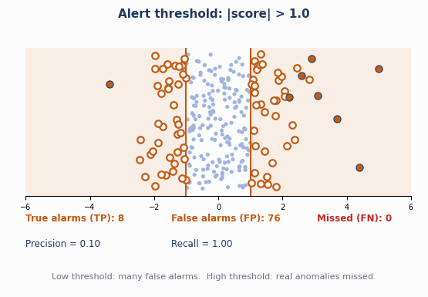
Visualization of Data, Understanding and Interpretation
Thresholds And The False-Alarm Trade-Off
Lower threshold: more true alarms, but many false ones.
Higher threshold: fewer false alarms, but real anomalies are missed.
Choose the cut-off from the relative costs, not from the score alone.
Animation: sweeping the alert threshold.
Source: Additional literature (syllabus row), not a section of the three textbooks (precision/recall trade-off); synthetic data — original animation generated for this lecture

Slide 40
Visualization of Data, Understanding and Interpretation
Measuring Detector Quality
Textbook reference: Additional literature (syllabus row), not a section of the three textbooks — standard evaluation measures (also used in the previous lecture’s anomaly-detection numerical)
Precision = TP / (TP + FP): of everything flagged, how much was real?
Recall = TP / (TP + FN): of all real anomalies, how many were found?
F1 = 2 × Precision × Recall / (Precision + Recall): one number balancing the two.
Accuracy = (TP + TN) / all can look excellent when anomalies are rare — a detector that flags nothing scores high — so report precision and recall.

Slide 41
Visualization of Data, Understanding and Interpretation
Uncertainty In Algorithmic Findings
Textbook reference: Wilke (TB1), Ch. 16 ‘Visualizing uncertainty’
Scores, baselines and cluster assignments are estimates, and estimates carry uncertainty.
Wilke (Ch. 16): showing no uncertainty invites over-confident reading; but uncertainty displays can themselves be misread as hard boundaries.
A flag near the threshold and a flag far beyond it are different findings and should not look alike.
Uncertainty sources here: sampling noise in the baseline, model error, and the choice of threshold.

Slide 42
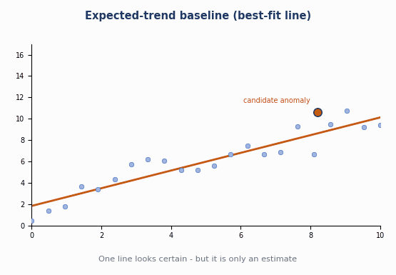
Visualization of Data, Understanding and Interpretation
Error Bars, Confidence Bands And Hypothetical Outcomes
Always say what a bar shows: standard deviation, standard error or a confidence interval.
A baseline fit gets a confidence band, not a single line.
A hypothetical outcome plot animates plausible fits; here the verdict flips.
Animation: is the candidate really anomalous?
Source: Wilke (TB1) Ch. 16 ‘Visualizing the uncertainty of curve fits’, ‘Hypothetical outcome plots’ — original animation generated for this lecture (synthetic data)

Slide 43
Visualization of Data, Understanding and Interpretation
Frequency Framing Of An Alert Probability (Original Diagram)
Textbook reference: Wilke (TB1), Ch. 16 ‘Framing probabilities as frequencies’ (idea applied to alert confidence)
“The model says: 70% likely a real anomaly”
Why it helps
Counting dots lets a reviewer see the chance of a false alarm directly.
Wilke notes that people read probabilities more reliably when they are framed as frequencies.
Quantile dotplots extend the idea: each dot is an equal slice of probability.
Harder to grasp as a bare percentage …
“Of 10 similar flagged cases, about 7 were real”
● real anomaly (7) ○ false alarm (3)

Slide 44
Visualization of Data, Understanding and Interpretation
Saliency And Attention In AI-Generated Highlights
Textbook reference: Ware (TB3), Ch. 5 ‘Visual Salience’ (G1.2, G5.4, G5.6); inattentional blindness as discussed by Ware
Saliency is how strongly an item stands out from its surroundings; salient items attract the eye first (Ware, Ch. 5).
Ware G1.2: important data should look more distinct than unimportant data — but an AI highlight is salient because of the model, not because it is important.
Attention is limited, and unexpected events outside the attended region are easily missed (inattentional blindness, cited by Ware).
So highlights shift attention toward flagged items and away from unflagged ones, where missed anomalies may be hiding.

Slide 45
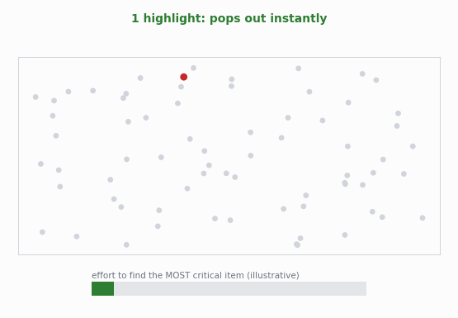
Visualization of Data, Understanding and Interpretation
When Highlights Lose Their Power
Pop-out works when the highlight is rare (Ware G5.6).
Flag too much and nothing stands out; the view becomes ‘all alarm’.
Graded emphasis restores a clear ranking.
Animation: 1 → 40 highlights, then graded.
Source: Ware (TB3) Ch. 5 (G5.6); Munzner §5.5.4; effort bar is illustrative — original animation generated for this lecture

Slide 46
Visualization of Data, Understanding and Interpretation
Alerting And Cognitive Load
Textbook reference: Ware (TB3), Ch. 5 (G5.9, G5.19); alarm-fatigue point: general human-factors practice
Ware G5.19: peripheral alerting cues must be stronger when cognitive load is expected to be high.
Ware G5.9: when colour and shape are in use, subtle motion or blink can highlight — as subtle as rapid search allows.
Matching alert strength to severity matters: constant strong alerts cause fatigue and are eventually ignored (additional human-factors literature).
Reserve the strongest cues for the few cases that need immediate action.

Slide 47
Visualization of Data, Understanding and Interpretation
Avoiding Visual Overemphasis Of Algorithmic Findings
Textbook reference: Ware (TB3), Ch. 5; Wilke (TB1), Ch. 16; Additional literature (syllabus row), not a section of the three textbooks — Parasuraman & Manzey (2010), Human Factors 52(3)
Scale emphasis to confidence and importance: strong cues only for strong findings.
Keep all the data visible; flags are a layer that can be toggled, not a replacement for the view.
Call flags ‘candidates’ and show the score or uncertainty so viewers can calibrate trust.
People can over-rely on automated aids (automation bias and complacency; Parasuraman & Manzey 2010) — design the view to invite checking, not to replace it.

Slide 48
Visualization of Data, Understanding and Interpretation
Design Checklist: Emphasis Scaled To Confidence (Example)
Textbook reference: Illustrative bands chosen for this lecture; principles from Ware (TB3) Ch. 5 and Wilke (TB1) Ch. 16
Score band | Encoding | Reviewer action
High (e.g., ≥ 0.90) | Strong hue + label + top of review queue | Review first
Medium (0.70–0.90) | Moderate hue, smaller mark | Review in order
Low (0.50–0.70) | Subtle outline only | Skim; sample
Below 0.50 | No emphasis; data stays visible | Not queued

Slide 49
Visualization of Data, Understanding and Interpretation
Putting It Together: An Anomaly Review View
Textbook reference: Synthesis of Munzner (Ch. 3, 5), Ware (TB3) (Ch. 5–6), Wilke (TB1) (Ch. 7, 12, 16)
Main view: the raw data, with flagged items marked by one distinct, sparing cue.
Context: seasonal or group baselines drawn beside the data, with their uncertainty.
Queue: flags ranked by score, each with a short generated reason and confidence.
Verification tools: details on demand, linked views, confirm / dismiss, and a toggle to hide the model layer.
Evaluation: track precision, recall and review time; revisit thresholds as feedback accumulates.

Slide 50
Visualization of Data, Understanding and Interpretation
Numerical 1: z-score And IQR Outlier Rules
Textbook reference: Worked example; IQR rule from Wilke (TB1) Ch. 9, z-score rule from standard statistics
Problem: ten response times (ms): 48, 52, 50, 47, 55, 49, 51, 53, 46, 98. Does the value 98 get flagged by (a) |z| > 3 and (b) the 1.5 × IQR rule?
Solution:
  Mean = 549 / 10 = 54.9. Sum of squared deviations = 2132.9; sample variance = 2132.9 / 9 ≈ 237.0; SD ≈ 15.4.
  z for 98 = (98 − 54.9) / 15.4 ≈ 2.80 → below 3, so NOT flagged. The outlier inflated the SD and hid itself.

Slide 51
Visualization of Data, Understanding and Interpretation
Numerical 1: z-score And IQR Outlier Rules (contd.)
Textbook reference: Worked example; IQR rule from Wilke (TB1) Ch. 9, z-score rule from standard statistics
  Sorted: 46 47 48 49 50 | 51 52 53 55 98. Q1 = 48, Q3 = 53 (medians of the halves), IQR = 5.
  Fences: 48 − 7.5 = 40.5 and 53 + 7.5 = 60.5. Since 98 > 60.5, it IS flagged.
  Lesson: robust rules (IQR) resist the masking that distorts mean-and-SD rules.

Slide 52
Visualization of Data, Understanding and Interpretation
Numerical 2: Precision, Recall, F1 And The Accuracy Trap
Textbook reference: Worked example; standard evaluation measures (Additional literature (syllabus row), not a section of the three textbooks)
Problem: 1,000 events contain 45 true anomalies. A detector flags 50 events; 36 of them are real. Compute precision, recall, F1 and accuracy.
Solution:
  TP = 36, FP = 50 − 36 = 14, FN = 45 − 36 = 9, TN = 1000 − 36 − 14 − 9 = 941.
  Precision = 36 / 50 = 0.72. Recall = 36 / 45 = 0.80.
  F1 = 2 × 0.72 × 0.80 / (0.72 + 0.80) = 1.152 / 1.52 ≈ 0.76.

Slide 53
Visualization of Data, Understanding and Interpretation
Numerical 2: Precision, Recall, F1 And The Accuracy Trap (contd.)
Textbook reference: Worked example; standard evaluation measures (Additional literature (syllabus row), not a section of the three textbooks)
  Accuracy = (36 + 941) / 1000 = 97.7%. But flagging nothing gives (1000 − 45) / 1000 = 95.5%, so accuracy says little here.

Slide 54
Visualization of Data, Understanding and Interpretation
Numerical 3: The Base-Rate Problem
Textbook reference: Worked example; probability reasoning (Additional literature (syllabus row), not a section of the three textbooks)
Problem: anomalies are 0.5% of 10,000 events. A detector catches 95% of true anomalies and falsely flags 2% of normal events. What fraction of its alerts are real?
Solution:
  True anomalies = 0.005 × 10,000 = 50; caught = 0.95 × 50 = 47.5.
  Normal events = 9,950; false alarms = 0.02 × 9,950 = 199.
  Total alerts = 47.5 + 199 = 246.5; precision = 47.5 / 246.5 ≈ 19.3%.

Slide 55
Visualization of Data, Understanding and Interpretation
Numerical 3: The Base-Rate Problem (contd.)
Textbook reference: Worked example; probability reasoning (Additional literature (syllabus row), not a section of the three textbooks)
  About four of every five alerts are false, despite a detector that looks accurate. Rare events make false alarms dominate — so show confidence and rank the queue.

Slide 56
Visualization of Data, Understanding and Interpretation
Numerical 4: Standard Deviation Versus Standard Error
Textbook reference: Wilke (TB1), Ch. 16 (standard deviation vs. standard error, confidence intervals)
Problem: a baseline has mean 100 and standard deviation 12 from n = 36 readings. A new reading is 125. Judge it using the SD and, wrongly, using the standard error.
Solution:
  Standard error SE = SD / √n = 12 / 6 = 2. A 95% confidence interval for the MEAN is about 100 ± 2 × 2 = 96 to 104.
  A single reading varies like the data, so use the SD: z = (125 − 100) / 12 ≈ 2.08 — borderline, not extreme.

Slide 57
Visualization of Data, Understanding and Interpretation
Numerical 4: Standard Deviation Versus Standard Error (contd.)
Textbook reference: Wilke (TB1), Ch. 16 (standard deviation vs. standard error, confidence intervals)
  Using the SE gives z = 25 / 2 = 12.5, which wildly overstates how unusual the reading is and would create false positives.
  Wilke (Ch. 16): say what an uncertainty measure describes — SD describes spread of observations, SE the precision of an estimate.

Slide 58
Visualization of Data, Understanding and Interpretation
Summary: Key Takeaways
Textbook reference: Sources: Munzner Ch. 2–3, 5; Wilke (TB1) Ch. 7, 9, 12, 16, 22; Ware (TB3) Ch. 1, 5, 6
AI output becomes visible through derived attributes (scores, cluster IDs, flags) encoded with suitable channels (Munzner).
Distribution and association views (Wilke Ch. 7, 12) show patterns and outliers directly; their parameters (bins, bandwidth) shape what we see.
Anomalies come in three kinds — point, contextual, collective — and each needs a different visual treatment.

Slide 59
Visualization of Data, Understanding and Interpretation
Summary: Key Takeaways (contd.)
Textbook reference: Sources: Munzner Ch. 2–3, 5; Wilke (TB1) Ch. 7, 9, 12, 16, 22; Ware (TB3) Ch. 1, 5, 6
False positives and false negatives trade off through the threshold; precision and recall, not accuracy alone, describe a detector.
Show uncertainty (Wilke Ch. 16) and keep the human able to verify.
Highlights are salient (Ware Ch. 5) whether or not they are important: scale emphasis to confidence and never hide the unflagged data.

Slide 60
Visualization of Data, Understanding and Interpretation
MCQs
1. An algorithm assigns every record an anomaly score. In Munzner’s framework this score is best described as:
A. A derived attribute
B. A visual channel
C. A dataset type
D. A validation method

Slide 61
Visualization of Data, Understanding and Interpretation
MCQs
1. An algorithm assigns every record an anomaly score. In Munzner’s framework this score is best described as:
A. A derived attribute
B. A visual channel
C. A dataset type
D. A validation method
Answer: A

Slide 62
Visualization of Data, Understanding and Interpretation
MCQs
2. A value that is normal overall but abnormal at a particular time of year is which type of anomaly?
A. Point anomaly
B. Collective anomaly
C. Contextual anomaly
D. Sampling bias

Slide 63
Visualization of Data, Understanding and Interpretation
MCQs
2. A value that is normal overall but abnormal at a particular time of year is which type of anomaly?
A. Point anomaly
B. Collective anomaly
C. Contextual anomaly
D. Sampling bias
Answer: C

Slide 64
Visualization of Data, Understanding and Interpretation
MCQs
3. A sensor flat-lines for 30 minutes although every individual reading lies within the normal range. This is best described as a:
A. Point anomaly
B. Contextual anomaly
C. Normal fluctuation
D. Collective anomaly

Slide 65
Visualization of Data, Understanding and Interpretation
MCQs
3. A sensor flat-lines for 30 minutes although every individual reading lies within the normal range. This is best described as a:
A. Point anomaly
B. Contextual anomaly
C. Normal fluctuation
D. Collective anomaly
Answer: D

Slide 66
Visualization of Data, Understanding and Interpretation
MCQs
4. A detector flags 50 events, 36 of which are real. There are 45 real anomalies in total. What is its recall?
A. 0.72
B. 0.80
C. 0.88
D. 0.36

Slide 67
Visualization of Data, Understanding and Interpretation
MCQs
4. A detector flags 50 events, 36 of which are real. There are 45 real anomalies in total. What is its recall?
A. 0.72
B. 0.80
C. 0.88
D. 0.36
Answer: B

Slide 68
Visualization of Data, Understanding and Interpretation
MCQs
5. Raising the alert threshold of a score-based detector will generally:
A. increase false positives and reduce false negatives
B. have no effect on either error type
C. reduce false positives but risk more false negatives
D. reduce both error types at once

Slide 69
Visualization of Data, Understanding and Interpretation
MCQs
5. Raising the alert threshold of a score-based detector will generally:
A. increase false positives and reduce false negatives
B. have no effect on either error type
C. reduce false positives but risk more false negatives
D. reduce both error types at once
Answer: C

Slide 70
Visualization of Data, Understanding and Interpretation
MCQs
6. According to Ware, for maximum pop-out a highlighted symbol should:
A. be the only item distinctive on that feature channel
B. share its colour with as many items as possible
C. use every feature channel, including blink, at once
D. match the background’s spatial frequency

Slide 71
Visualization of Data, Understanding and Interpretation
MCQs
6. According to Ware, for maximum pop-out a highlighted symbol should:
A. be the only item distinctive on that feature channel
B. share its colour with as many items as possible
C. use every feature channel, including blink, at once
D. match the background’s spatial frequency
Answer: A

Slide 72
Visualization of Data, Understanding and Interpretation
MCQs
7. Why can a view with prominent AI highlights lead to missed anomalies?
A. Algorithms cannot produce false negatives
B. Highlighted marks are always drawn smaller
C. Red always hides the underlying data
D. Attention goes to flagged items, so unflagged cases get less scrutiny

Slide 73
Visualization of Data, Understanding and Interpretation
MCQs
7. Why can a view with prominent AI highlights lead to missed anomalies?
A. Algorithms cannot produce false negatives
B. Highlighted marks are always drawn smaller
C. Red always hides the underlying data
D. Attention goes to flagged items, so unflagged cases get less scrutiny
Answer: D

Slide 74
Visualization of Data, Understanding and Interpretation
MCQs
8. Which practice does Wilke (Ch. 16) recommend for error bars?
A. Omit the explanation, since readers know what they mean
B. State whether the bar shows SD, SE or a confidence interval
C. Use the standard error to describe the spread of individual observations
D. Replace every bar with a single point estimate

Slide 75
Visualization of Data, Understanding and Interpretation
MCQs
8. Which practice does Wilke (Ch. 16) recommend for error bars?
A. Omit the explanation, since readers know what they mean
B. State whether the bar shows SD, SE or a confidence interval
C. Use the standard error to describe the spread of individual observations
D. Replace every bar with a single point estimate
Answer: B

Slide 76
Thank You

